Slide 1
Fraud Detection
A Technical Overview of Our Process
Notes:
Vivian

Slide 2
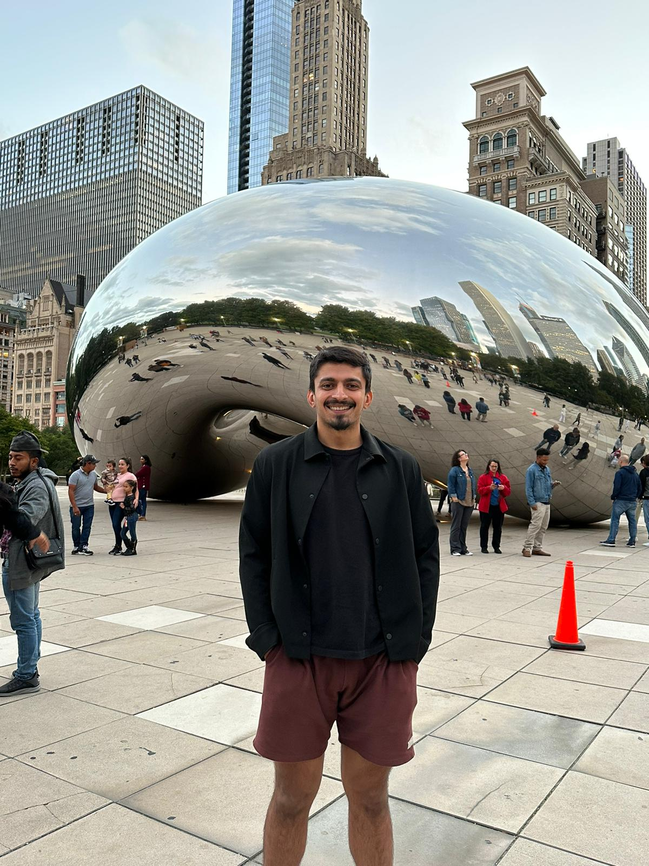
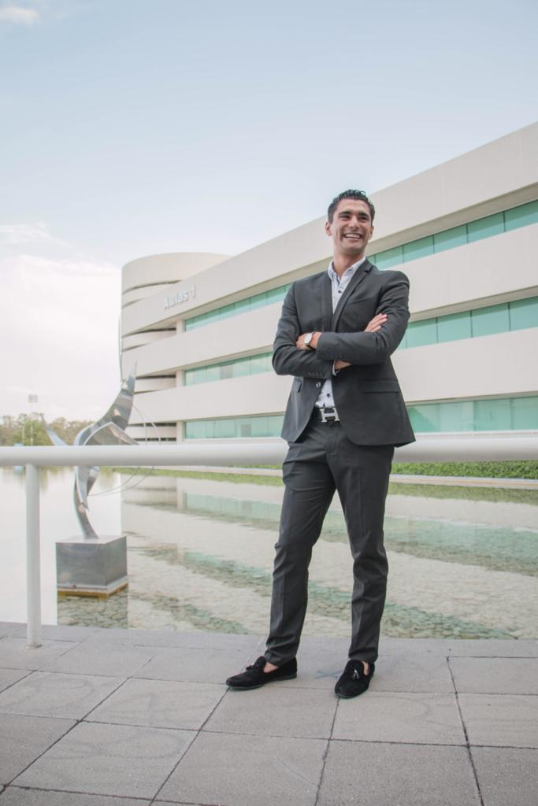
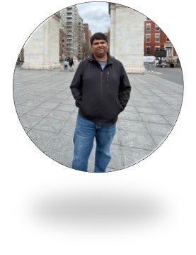
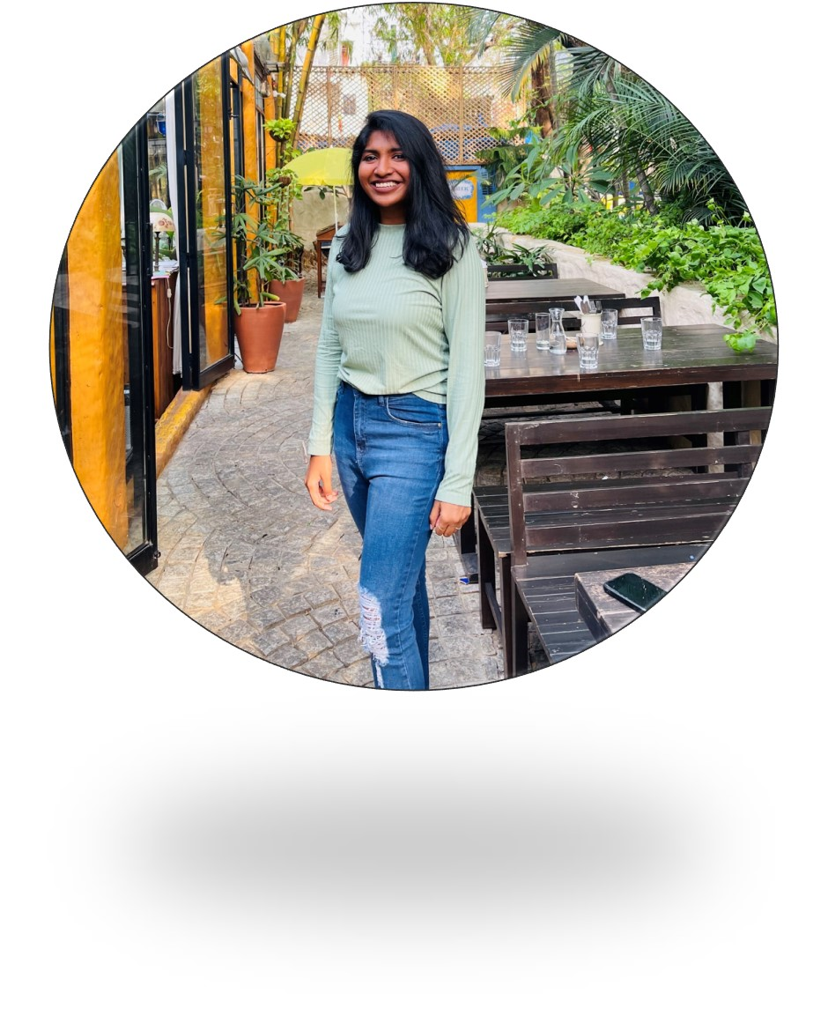

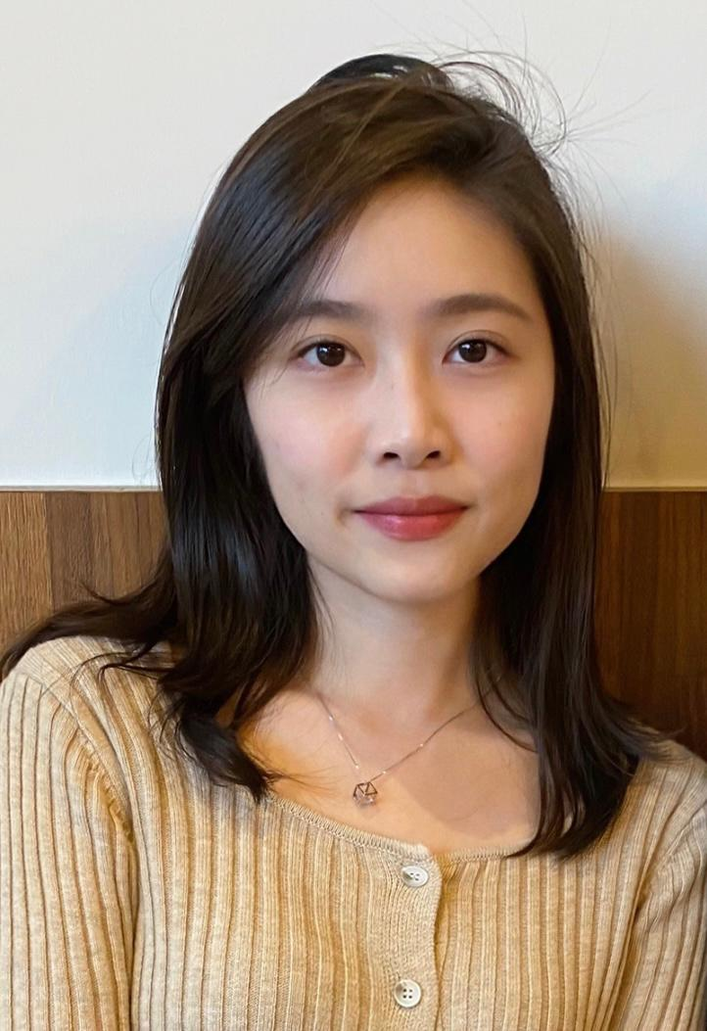
Our team
ABHISHEK
PANDIT
JOSE
GERALA
SIDDHARTH
PURANAM
SWATHI
GANESAN
VISHAL PARAMESWARAN
VIVIAN
YEH
Notes:
Vivian

Slide 3
Problem Statement
Our approach to addressing
Your issue of Credit Card Fraud and its impact on
Customer Satisfaction Rates
is to design and build a more
Precise Credit
Card Fraud Detector
via a Supervised learning model that will help us identify
Fraudulent Credit Card Transactions
thus, achieving a more Satisfied
Customer Base by
Minimizing the Number Of Denied Transactions.
Notes:
Vivian: We are here to propose a solution. Our approach to addressing your issue of credit card fraud and its impact on customer satisfaction rates is to design and build a more precise credit card fraud detector via a supervised learning model that will help us identify fraudulent credit card transactions and thus, achieving a more satisfied customer base by minimizing the number of denied transactions.

Slide 4
OUR MODEL DELIVERS
$100K
Revenue Generated
95%
Model Precision
Notes:
Vivian: By using our model and following our approach, we are expecting to have a 100k reduction in costs and our model has a 95% precision, which means that 95% of the time our model is able to accurately identify transactions that are actually fraudulent. So with these targets in mind, my teammates will go into details on how we are able to achieve these.

Slide 5
Exploratory data analysis

Slide 6
Amount
ALL
FRAUD TRANSACTIONS
TRANSACTIONS
AMOUNTS
Notes:
Abhishek: Fraud by Amount - As is clear from the chart, the amount vs fraud is a trimodal graphs. And while peaks around smaller dollar amounts are not major pain points, the area around the peak of $900 covers almost 30-40% of fraud cases and should be the point of emphasis going forward.

Slide 7
TRANSACTION HOUR
ALL
FRAUD TRANSACTIONS
TRANSACTIONS
TRANSACTION HOUR
Notes:
Abhishek: Fraud by Hour of Day - Like fraud by amount, fraud by hour of day has some clear trends as well. A higher fraction of the fraud cases are concentrated at night.

Slide 8
category
ALL
FRAUD TRANSACTIONS
TRANSACTIONS
TRANSACTION HOUR
Notes:
Abhishek: Category - There were varying trends of frauds across different categories as well, some seeing higher fraction of frauds than others. Shopping Networks, Grocery Point of Sale, Gas Stations, all these saw higher cases of fraud compared to other categories. This might suggest knowledge of the fraud detection algorithms on the part of fraudsters since these categories are run-off-the-mill categories which will not warrant attention unless the amounts are higher than usual.

Slide 9
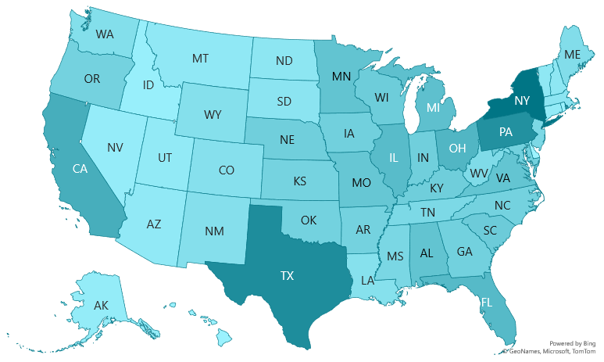
GEOGRAPHY
Notes:
Abhishek: Geography - The fraud cases were not spread out evenly across the country. The areas with higher number of transactions also saw higher numbers of fraud transactions, states of New York and Texas being the two highest. Since there is no implicit connection between number of transactions and number of fraud transactions, we believe that the fraudsters are cognisant of the number of transactions and are using their sheer number in New York and Texas to disguise themselves.

Slide 10
Feature engineering

Slide 11
Data preparation
DoB
Transaction Time
Amount
Age
Hour
Month
60 Day
Avg 60 Day
Category
Gender
Dummy Variables
Notes:
Swathi:
Making derived columns :created age from DOB. Computed hour of day and month from Datetime col
One hot encoding :Our ML model cannot operate on label data directly and hence requires all input variables and output variables to be numeric. We convert categorical data to a numerical form by creating dummy variables for Category and Gender columns

Slide 12
Over sampling
Since the amount of data collected is insufficient, we would need to perform oversampling.
When one class of data is the underrepresented minority class in the data sample (#fraud in our case), over sampling is used to duplicate these results for a more balanced number of positive results in training.
Oversampling can potentially improve models trained on imbalanced data.
No Fraud
Fraud
Notes:
Swathi:
Making derived columns :created age from DOB. Computed hour of day and month from Datetime col
One hot encoding :Our ML model cannot operate on label data directly and hence requires all input variables and output variables to be numeric. We convert categorical data to a numerical form by creating dummy variables for Category and Gender columns
Since the amount of data collected is insufficient, we would nee to perform oversampling.
When one class of data is the underrepresented minority class in the data sample(#fraud in our case), over sampling is used to duplicate these results for a more balanced number of positive results in training.
Oversampling can potentially improve models trained on imbalanced data.

Slide 13
Model definition

Slide 14


Precision vs sensitivity
Precision
Sensitivity
Of all the transactions that we predicted as fraud, how many did we get correct.
Out of all the Fraud in the dataset, how many of them did we get correct
Notes:
Vishal: Precision is the Percentage of correct Fraud transactions amongst all transactions that we predicted as fraud and the Sensitivity / Recall is the percentage of identifying a correct fraud transaction amongst all the fraud transactions.

Slide 15
Model comparison
Precision
Recall
Precision
Recall
0.81 | 0.90
0.88 | 0.79
0.85 | 0.93
0.92 | 0.83
0
0
Logistic Regression
Decision Tree
1
1
Precision
Recall
Precision
Recall
0.82 | 0.96
0.95 | 0.79
0.93 | 0.95
0.95 | 0.93
0
0
Random Forest
XGBoost
1
1
Notes:
Vishal: These are the results of our models.

Slide 16
Model comparison
precise
XGBoost
Random forests
decision tree
insensitive
sensitive
Logistic regression
imprecise
Notes:
Vishal

Slide 17
Feature importance
Importance
features
Notes:
AP

Slide 18
Economic value

Slide 19
Economic Value
For Every 10,000 Fraudulent Transactions
 | Previous | OURs | Dif.
Transaction Success | 6,000 | 9,500​ | 3,500​
Transaction Failure | 4,000 | 500​ | -3,500
total | 10,000​ | 10,000
Failed Transactions that retry​ (50%) | 2,000​ | 250​ | -1,750​
Failed Transactions that quit​ (50%) | 2,000 | 250​ | -1,750​
Value Lost* | $136,000​ | $35,904​ | $100,096​
* The Average transaction cost was $68
Notes:
Siddharth : After a Transaction is detected as Fraud 50 % retry the transaction 50 % don’t finish the transaction / pay by cash.
Assuming the prior model was Logistic Regression Values Giving our model the XG boost model results In our Data set
The Avg Fraud Transaction is $528 The Avg non-Fraud Transaction is $68.

Slide 20
Future plans

Slide 21




Open questions
Customers
First to market
Do you have more info about the customers that are complaining?
Location?
What is the maximum fraud amount you are willing to be liable for?
Testing
Insurance?
What is your experience with the previous model?
Do you have Fraud insurance?
Notes:
Jose

Slide 22

Future Improvements
Security
Performance
Implement enhanced security for high value transactions in the night.
Improve model performance, with a wider range of data and also customer complaints data
Notes:
Jose

Slide 23
summary
Increase Model Precision
Identified Important Features
Cleaned and Prepared Features
Created 4 Models, and found the best amongst them
Estimated the Economic Benefits with best model

Slide 24
Thank you

